Slide 1
Annotation Using ACAPS

Slide 2
I understand how to annotate using ACAPS
I can define; author, context, audience, purpose and significance
I can annotate a historical source

Slide 3
Understand how to analyse a historical source
READ WITH ME
EVIDENCE=
The information gathered from a historical source.

Slide 4
Understand how to analyse a historical source
READ WITH ME
EVIDENCE=
The i_________________ gathered from a h___________ s____________.

Slide 5
Understand how to analyse a historical source
There are two types of evidence used in history.
Primary Sources
Secondary Sources

Slide 6
Understand how to analyse a historical source
How do we find out information from a historical source?
What are looking for?
Are sources easy to understand?
Could a source have multiple meanings?
What questions should we be asking?

Slide 7
Understand how to analyse a historical source
One easy way of analysing sources that you will need to know for your assessment next week is annotating using ACAPS.
ANNOTATION = making notes directly onto a historical source through; circling, underlining, highlighting, labeling etc.
ACAPS is an acronym that stands for:
A = author
C= context
A = audience
P = purpose
S = significance

Slide 8
I understand how to annotate using ACAPS
AUTHOR =
Name of the person or organisation that created the source.
If no author: who might have made it?

Slide 9
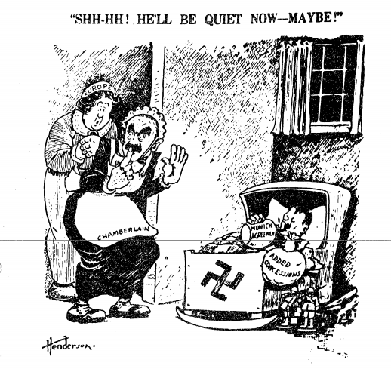
I understand how to annotate using ACAPS
How do I annotate for the author?
Look for a caption or authors signature.
Look for capital letters (names are proper nouns)
Label – Author
Author
SOURCE 1: Henderson, 1938

Slide 10
I understand how to annotate using ACAPS
CONTEXT =
Important events that were occurring during the time the source was made. Dates, details etc.

Slide 11
Hitler – represented as baby
I understand how to annotate using ACAPS
How do I annotate for the context?
Look for the date
Identify and note events that were occurring during this time period
Label what figures, symbols and words are representing
Europe and the Uk (represented by PM Chamberlain)
are child carers trying to calm a baby by allowing them there wishes
Nazi Party
The bottle calming Hitler is the Munich Agreement – signed by Chamberlain in 1938
SOURCE 1: Henderson, 1938

Slide 12
I understand how to annotate using ACAPS
AUDIENCE =
The group of people the author is aiming to view/read the source.

Slide 13
I understand how to annotate using ACAPS
How do I annotate for the audience?
Look for clues;
What language is it written in?
How are the people/ideas shown?
What is it about?
Who might care about this? Age, nationality, interests etc.
Suggest an audience
Audience = People in allied countries who are concerned if the Policy of Appeasement will work
SOURCE 1: Henderson, 1938

Slide 14
I understand how to annotate using ACAPS
PURPOSE =
The reason the author created the source. What they wanted the audience to do, think or feel.

Slide 15
I understand how to annotate using ACAPS
The meaning of the text is -Will Hitler stop breaking the Treaty of Versailles after he is given Czechoslovakia?
How do I annotate for the purpose?
What is the context?
What is the main idea (message)
Does the author want you to do something? Think something? Or feel something?
PURPOSE = To make the audience feel worried about if the Policy of Appeasement will work to stop Hitler’s rise
SOURCE 1: Henderson, 1938

Slide 16
I understand how to annotate using ACAPS
SIGNIFICANCE =
The importance of the source.

Slide 17
I understand how to annotate using ACAPS
How do I annotate for the significance?
Why is the message of this source important?
What interesting perspective does it suggest?
Note the significance
SIGNIFICANCE= This source is important as it raises the idea that;
1. The Policy of Appeasement may fail
2. Chamberlain and Europe are giving in to Hitler as if he were a child
SOURCE 1: Henderson, 1938

Slide 18
I understand how to annotate using ACAPS
TAKE DOWN THESE NOTES
ACAPS
AUTHOR = Name of the person or organisation that created the source.
CONTEXT = Important events that were occurring during the time the source was made.
AUDIEINCE = The group of people the author is aiming to view/read the source.
PURPOSE = The reason the author created the source. What they wanted the audience to do, think or feel.
SIGNFICANCE = The importance of the source.

